Slide 1
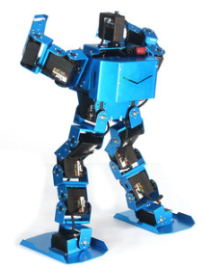
Biped Robot
Fahad
Mohammed
Naif

Slide 2
Introduction
The project is to make a robot which provide a sufficient way to perform different actions
It is a Design Project
Developing a robot with the challenges
  BiPed Racing
  BiPed Freestyle Dancing
  Balancing Robot
These actions will perform by the Robot using the remote controller to act according to the user choice

Slide 3
Sponsors
Project is sponsoring by “GORE”
Sponsorship is important for the design project
Helps in creating a unique project when the sponsor supports with the budget
Sponsors help in generating a unique product with their own requirements
Sponsors put a key eye on the project and point out the errors time by time in the project to resolve those issues
Becomes easy to manage the product under the sponsors observation.

Slide 4
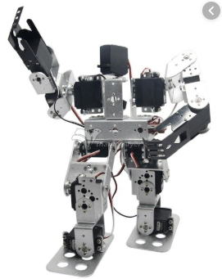
Background
BiPed robots have already designed with
different configurations
A BiPed robot with 17 degrees of Freedom has
developed with capability of Racing, Walking,
Dancing, Balancing, Turning around and Stretching
Robot is using servo motors at the joints for
maximum Degree of Freedom
Controls through Bluetooth module using the controller
Figure 1 [1]

Slide 5
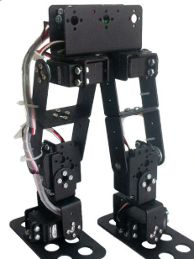
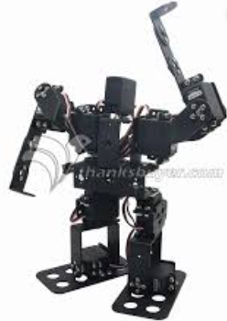
Benchmarking
Multiple BiPed robots have designed with different shapes and different degree of freedoms
6 Degree of Freedom with walking capacity only
Using the servo motors at the joints
Another Robot has developed with 9
Degree of Freedom
Figure 2 [2]
Figure 3 [3]

Slide 6
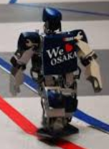
Benchmarking
Marathon Walking Robot with line following assessment
Walk in consistent speed for long time
Follows the road map using the line
Walk in straight line direction, curved line direction
Speed of walking can increase or decrease
Long term battery support
Figure 4 [4]

Slide 7
Literature Review - Fahad
Planning BiPed Walking Patterns [5]
  This journal article has provided with the patterns through which BiPed can walk like a human
  It is easy for BiPed robots to walk but their stability is bad and it topple over while taking the step in forward or backward direction
  Need to balance them by finding the best height of feet at which it can easily shift the center of gravity from one leg to the other leg and take the step
  Different angles of feet and legs have presented in the article which will help the team in generating the walking Pattern

Slide 8
Literature Review – Mohammed
Biped Balance Control by Reinforcement Learning [6]
  An article described the BiPed robot for balancing on single leg and two legs
  All the angles have presented through which BiPed robot can stand and balance
  In the article dynamic models have presented regarding the balancing of BiPed with the inventions that can control the robot in all the situations if it is going to fall down.
  This article will help the team in creating the design of the project

Slide 9
Literature Review - Naif
Concept and Construction of a Robot Dance System [7]
  A dance steps formation has presented in this article.
  Explained the steps possible to make with the BiPed robot for dance
  Examine the angles for the dance preposition
  Focused on the stability and lifting angles
  Shifting of center of gravity has described
  This article is useful for the team to understand the dance composition steps for the freestyle while developing the project

Slide 10
Customer Requirements
Customer Requirements have generated after meeting and from the Robogames rules
Customer Requirements are the one which need to fulfill by the project when it will ready
A formulated table has generated for the Customer Requirement
Contains all the important points as per the description of project
By making customer requirement table it becomes easy to understand the project

Slide 11
Customer Requirements
CR’s Table
Customer Requirements
Two Legged BiPed Robot
Reciprocal Linear Mechanism
Forward and Backward Motion
Safe to Use
Remotely Control
Long battery backup
Smooth Transition
Racing speed can control
Capable of Balancing in all directions
Perform dancing
Reliable
Long lasting Durable

Slide 12
Engineering Requirements
Engineering Requirements explains the technical points which are necessary to follow
Engineering Requirements have generated from the project description, customer requirements and Robogames rules
These technical values helps in selecting the design, components and other parts of the project
Engineering Requirements helps in testing the project physically by examining the product and compare the testing values with the initial Engineering requirement values.

Slide 13
Engineering Requirements
ER’s table
Engineering Requirements | Operational Values
Dimension | Less than 120 cm
Battery Time | 180 seconds
Walking length capacity | 3 meters
Height | 20 cm
Foot length | 4 cm
Degree of Freedom | 6 Degrees
Width | 6 cm

Slide 14
House of Quality
House of Quality table provide the way to determine the relation between customer requirements and engineering requirements.
Engineering requirements can prioritize through the HoQ
Relative technical values shows the importance of each engineering requirement
House of Quality table has presented in Appendix A.
Results of HoQ has shown that Dimensions of Robot is the most important ER and Battery time is the least important engineering requirement.

Slide 15
Schedule
Schedule has formed in the Gantt chart and presented in Appendix B.
We are currently at the start of project and done with the client meetings.
Literature review, background research has done for the project
Now we will work on concept generation

Slide 16
Budget
Here is the budget
Total Budget | $1500
Anticipated Budget | $600
Advertisement Budget | $200
Prototype Cost | $400
Contingency Budget | $200
Unused Budget | $100

Slide 17
Reference
[1] https://www.google.com/search?q=biped+robot+with+racing&sxsrf=ACYBGNS8H9Fl0Xnex3nCqjZiWVqlwc_vbQ:1568430603180&source=lnms&tbm=isch&sa=X&ved=0ahUKEwi2hdSnq8_kAhXPPsAKHW9oBNsQ_AUIEigB&biw=853&bih=693#imgrc=I0pndJoh0IsPlM:
[2] https://www.google.com/url?sa=i&source=images&cd=&cad=rja&uact=8&ved=&url=https%3A%2F%2Fwww.aliexpress.com%2Fitem%2F6-DOF-biped-robot-walking-race-robot-entry-level-robot-accessories%2F32934291395.html&psig=AOvVaw0n3Cw_TzGPs2VEFo9NJmvS&ust=1568517105073507
[3] https://www.google.com/url?sa=i&source=images&cd=&cad=rja&uact=8&ved=&url=https%3A%2F%2Fwww.solidrop.net%2Fproduct%2Fassembled-9dof-humanoid-biped-robotic-educational-robot-with-bracket-ld-1501mg-servo-for-racing.html&psig=AOvVaw0n3Cw_TzGPs2VEFo9NJmvS&ust=1568517105073507
[4] https://www.google.com/url?sa=i&source=images&cd=&cad=rja&uact=8&ved=&url=https%3A%2F%2Fwww.cnet.com%2Fnews%2Fbiped-robot-marathon-kicks-off-in-osaka%2F&psig=AOvVaw0n3Cw_TzGPs2VEFo9NJmvS&ust=1568517105073507
[5] Q. Huang, “Planning Walking Patterns for a Biped Robot”, Vol. 17, No. 3, June 2001
[6] K. Hwang, “Biped Balance Control by Reinforcement Learning”, Published by Semantic, 2016 https://www.semanticscholar.org/paper/Biped-Balance-Control-by-Reinforcement-Learning-Hwang-Lin/1d40ca8bcd772aebcfbd072f4a3bcdc30cde21f1
[7] K. Shinozaki, “Concept and Construction of a Robot Dance System”, published in Proceedings of SPIE, December 2007 https://www.researchgate.net/publication/220222176_Concept_and_Construction_of_a_Robot_Dance_System

Slide 18
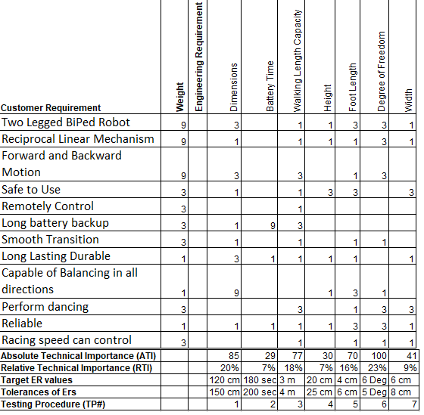
APPENDIX A - HoQ
House of Quality Table

Slide 19
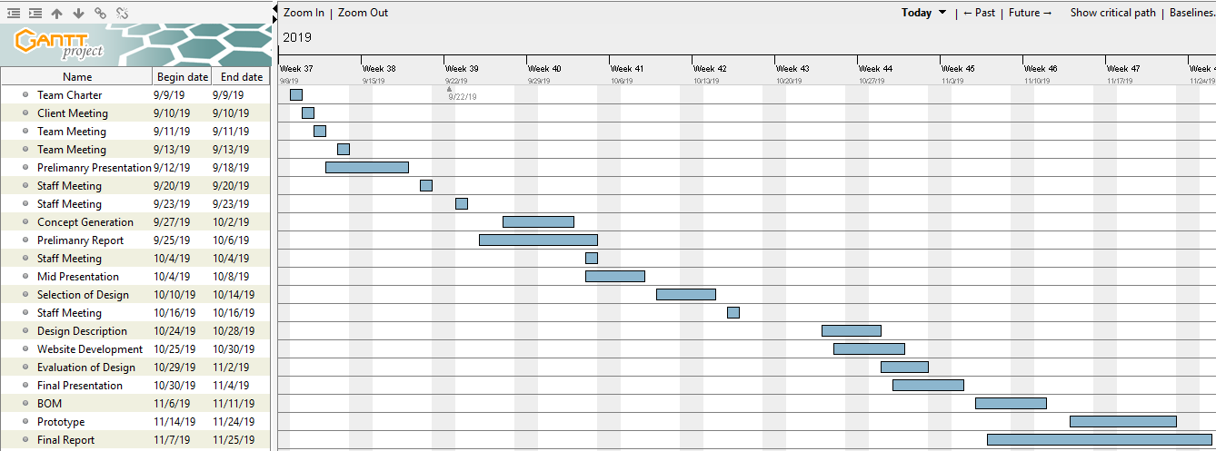
Appendix B – Gantt Chart

